Slide 1
Soccer Quality by Country
Edmond Leahy

Slide 2
Dataset(s)
For this project, the European Soccer Database dataset was used.
https://www.kaggle.com/hugomathien/soccer

Slide 3
Motivation
In the soccer world, the English Premier League is often said to be the best soccer league to watch in terms of quality. I have heard this all my life, while wondering if this was true. I have watched many soccer games from many countries, and have found that other leagues are just as exciting to watch, if not more exciting. I wanted to find out what the data showed.

Slide 4
Research Question(s)
Is England the most exciting soccer country in the world, in terms of goals per game and goals per country?

Slide 5
Methodology
By using a combination of techniques taught in the Python for Data Science course, I was able to manipulate the dataset to show the relevant statistics to the research question.
The following are some of the techniques used:
SQL querying
DataFrame Filtering
DataFrame merging
Matplotlib graphing

Slide 6
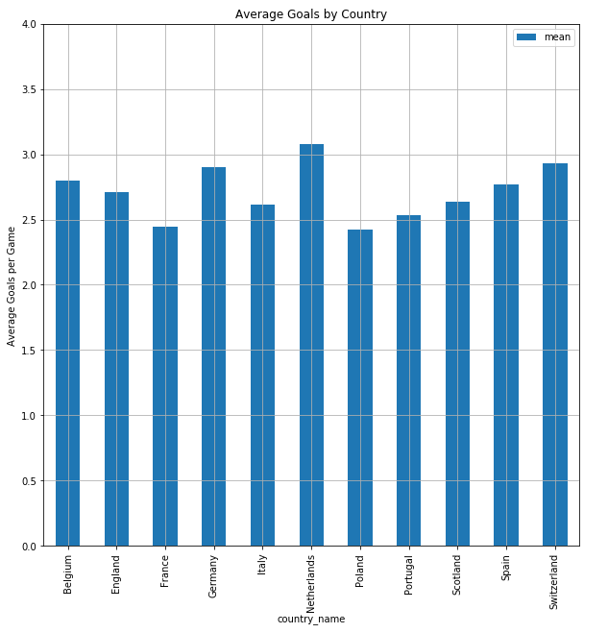
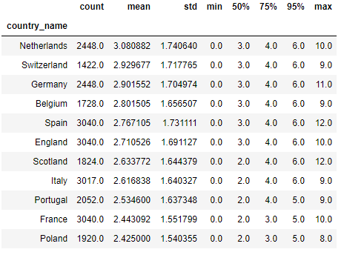
Findings –Goals Per Game(1)
The results of grouping the dataset by country gave the following results for the average number of goas per game :

Slide 7
Findings – Goals Per Game(2)
As the plot in the previous slide shows, the top three countries in terms of goal average per game are: Netherlands, Switzerland, Germany. England, however, is listed as sixth.
But looking at the table shown in the previous slide, I notice that the sum of goals scored per country might show a different story. This is explored in the following slide

Slide 8
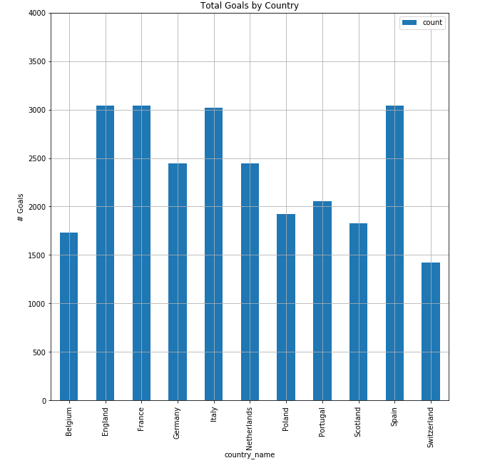
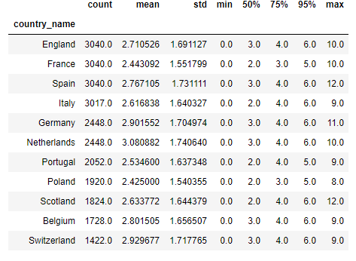
Findings –Total Goals(1)

Slide 9
Findings –Total Goals(2)
As shown in the previous slide, the top three countries in term of total goals are:
England, France, and Spain. All of these countries have the same number of goals.
As a note, Spain had the highest scoring game recorded out of the three, so this might raise their level of excitement too!

Slide 10
Findings - Conclusions
To conclude the results of the findings, it is clear that England is not a stand-alone country in terms of goals per game and overall goals.
The statement that England has the best soccer games would depend heavily on how you define a good soccer game. In terms of average goals per game, England does not have the best soccer games. In terms of total goals, it is tied with France and Spain.

Slide 11
Acknowledgements
This project was limited by the dataset used. Ranking soccer by countries in terms of Goals per game and Total goals is not a complete story of the quality of soccer. Many other factors influence the quality of the game, and many of these factors are subjective. This project was chosen to have a small scope for simplicity.

Slide 12
References
I used the bleacher report article to gain some knowledge on how to rank games:
https://bleacherreport.com/articles/1922780-statistically-ranking-the-worlds-top-10-football-leagues#slide0
I extensively used Edx’s Python for Data Science course reference material:
https://courses.edx.org/courses/course-v1:UCSanDiegoX+DSE200x+3T2019/course/

